Slide 1


This exhibition tells stories of people from St Mary’s Bramall Lane Family Choir in Sheffield.
Each person here lives with strength and dignity whilst facing the challenges of life on the frontline of poverty.
Each person is a creative soul, hard-working, with skills to share and a dream. Their economic circumstances have not yet allowed them to realise their dreams...
Each person has a reality that they live with as part of life on a low income.
Both the dreams and the realities are depicted in the portraits, painted by Stephen Martin.
The portrait project was funded by Church Action on Poverty as part of the Let’s End Poverty campaign (www.letsendpoverty.co.uk). The portraits toured the UK during 2024, with community events at each site they visited, to raise awareness and support for action to end poverty.

Slide 2
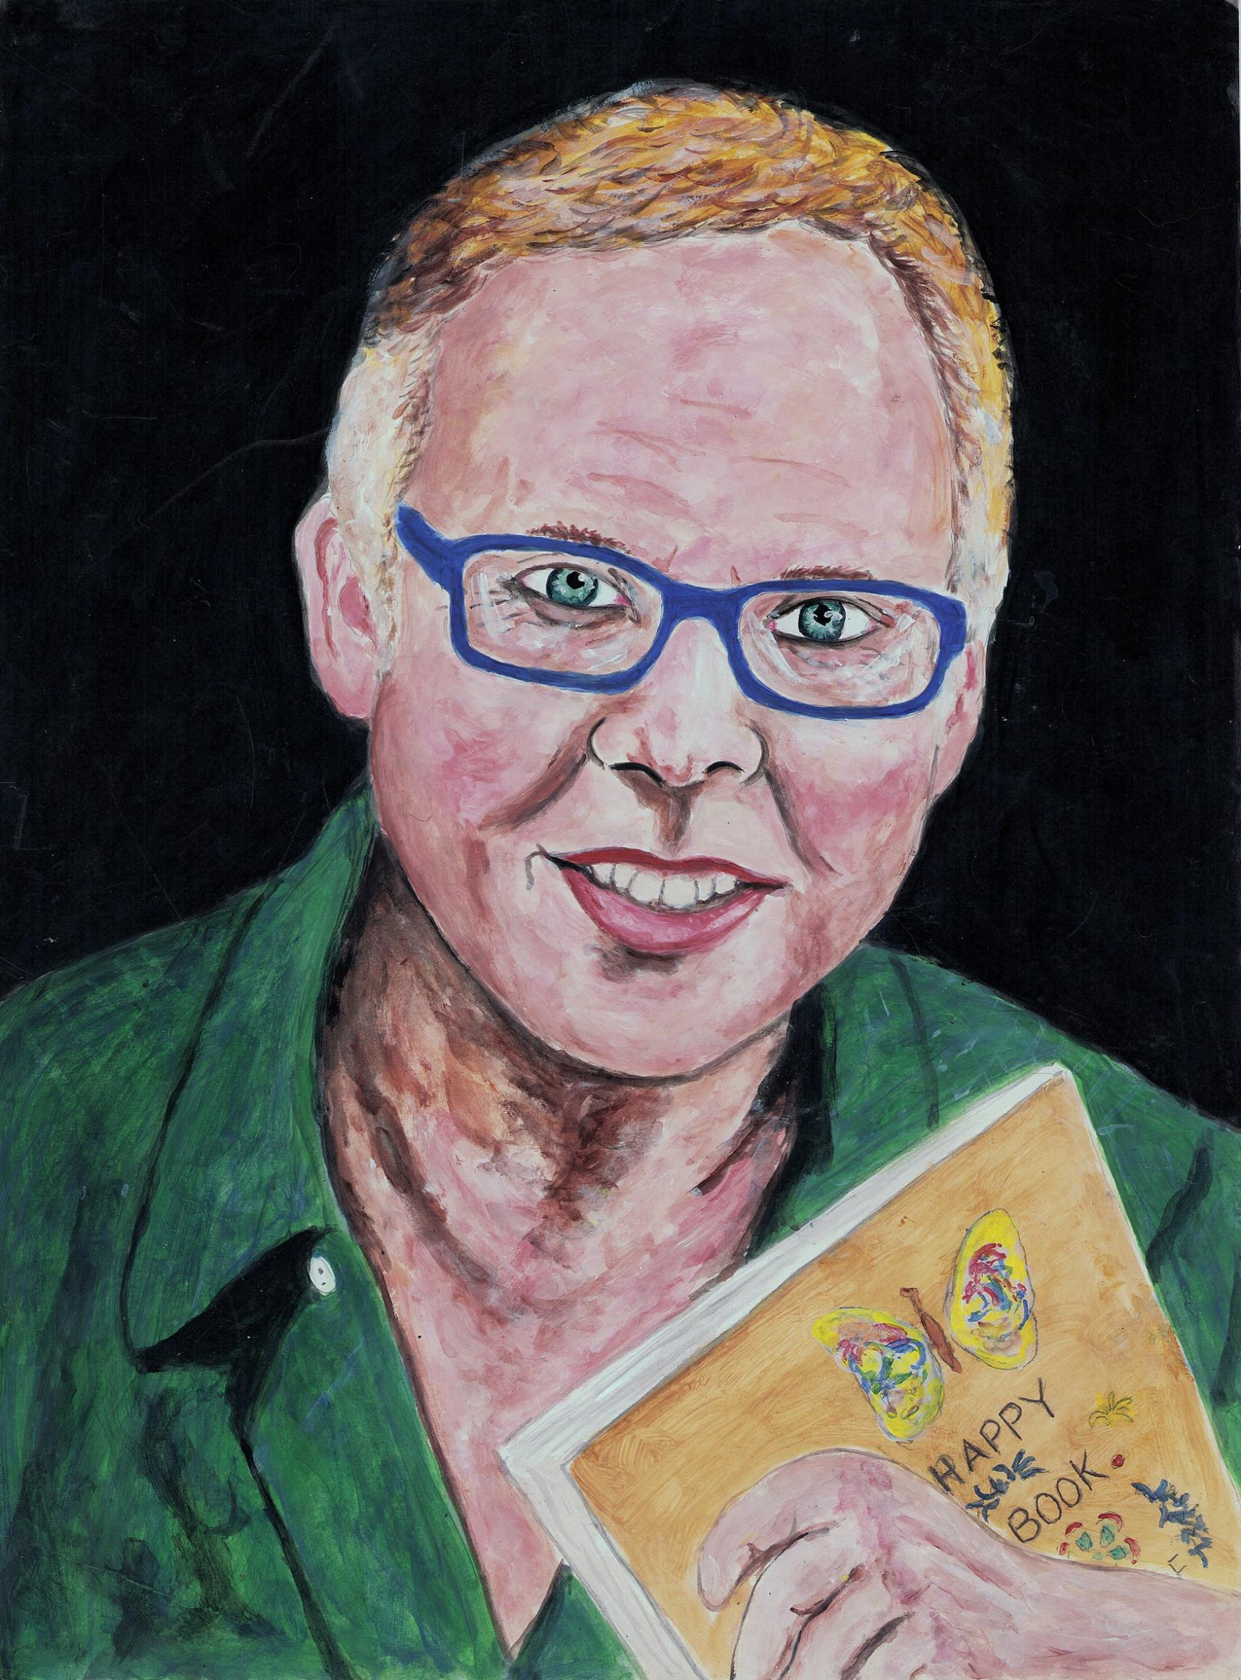
STEPHEN
After 15 years in childcare, Stephen (born 1959) worked as a gardener for 22 years.
He is also a painter, having trained for a diploma in Fine Art and photography in 1985. Stephen went on to complete a degree in Art History in 1997 and came back to painting during lockdown, after a 35 year hiatus, specialising in portraits.
Stephen has painted all the 'Dreams and Realities' portraits, including his own.
Stephen's dream is to safeguard his own mental health long-term. On the advice of his Community Development Wellbeing Group, he keeps a journal of positive events in his life as they occur and this book is shown in his portrait.
While painting the pictures, Stephen could only garden part-time due to long Covid. His income included Universal Credit and some months his total income was £340 (£11.18 per day).
Living on the frontline of poverty meant Stephen's reality was that he could not afford to rewire the family home where he lived. There was no gas or electricity. His house was dark from sunset.
Since the end of the tour, Stephen is now in far more suitable accommodation. He says: “My life has drastically changed for the better, I've been on state pension for two months which is double what I got on benefits, and my house has been on the market for three weeks and is attracting interest.”

Slide 3
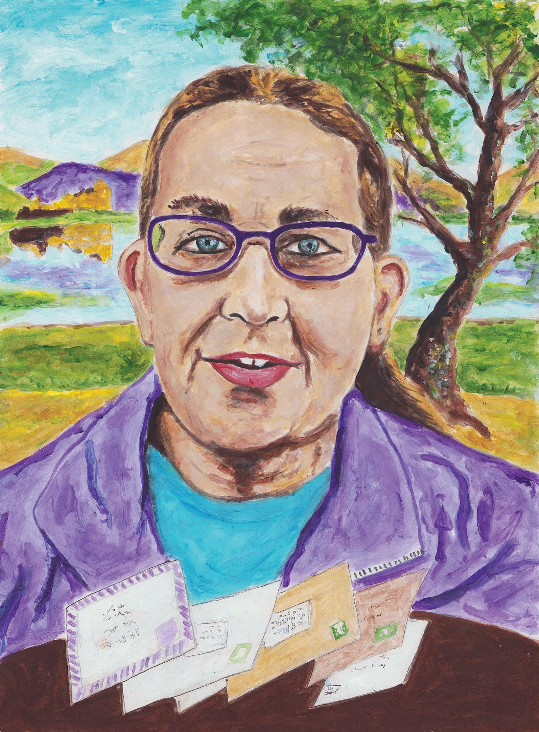
SUSAN
Susan (born 1960) has sung with St Mary’s choir since 2022.
She is a craftsperson and a carer for her husband who lives with angina and type two diabetes. Susan also lives with angina and rheumatoid arthritis, and is out of work due to ill health and her caring responsibilities.
Her caring has recently been curtailed, due to a fall on the bus as it drove off, which left her in severe pain.
Susan’s dream is to be able to visit her daughter who lives in Hawick, Scotland.
Susan’s reality is that she cannot afford to pay her bills let alone the fare to Scotland.
Since the tour was completed, Susan says, “A few things have changed, and I'm working part-time now. It's a start.”

Slide 4
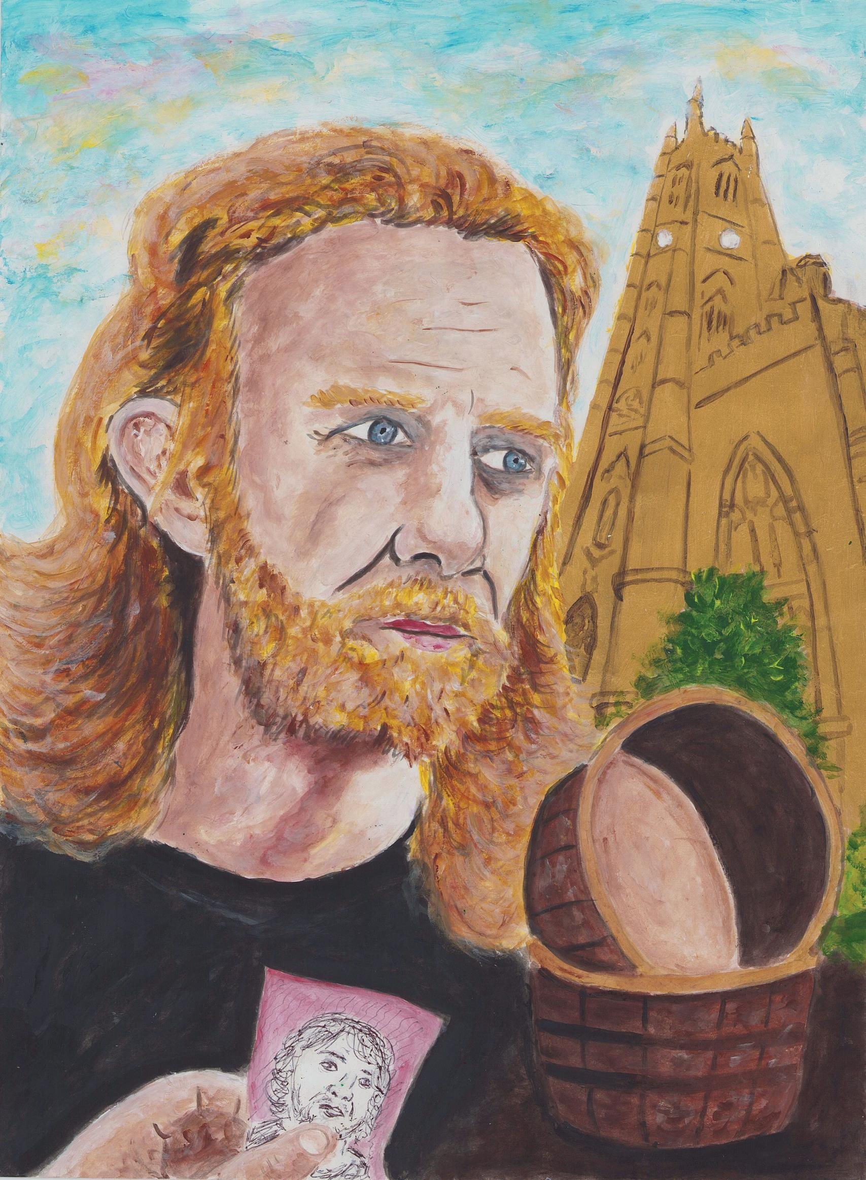
DAMIAN
Damian is an artist who captures energetic, everyday scenes using pen and paper.
Damian has been involved in the community activities at St Mary’s Church and Centre since 2018. He was involved in Timebuilders, part of the mental health cafe, art for wellbeing, litter pick and gardening.
Damian’s dream of provision is represented by a golden St Mary’s.
His reality of living on the frontline of poverty is that he is often scraping the bottom of the barrel, down to his last penny before he has paid for all his needs.

Slide 5
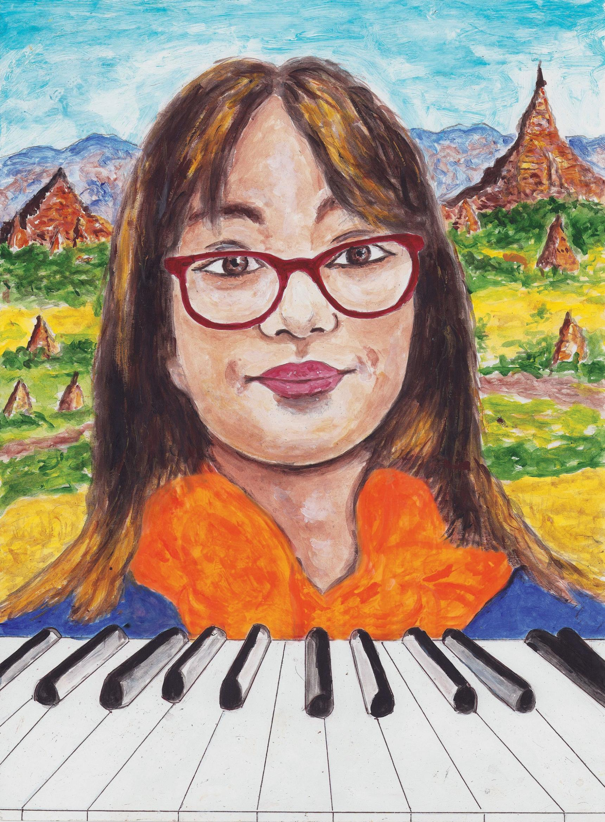
REBECCA
Rebecca (born 2008) is a secondary school student and gifted young musician. She and her family are political refugees from Myanmar (formerly Burma).
Rebecca’s mother, Lweemoo, was just a child when her family sought refuge in Thailand during a military uprising in Myanmar.
Lweemoo grew up in refugee camps, where she later met Rebecca’s father, Paulu. Lweemoo and Paulu married and had two sons before coming to England as refugees in 2007. Rebecca was then born in the UK, as was her younger brother.
Rebecca’s dream is to have piano lessons.
Her reality is that her family “live on paycheque to paycheque with just enough to buy food and pay bills.” They cannot travel to see relatives in Myanmar.

Slide 6
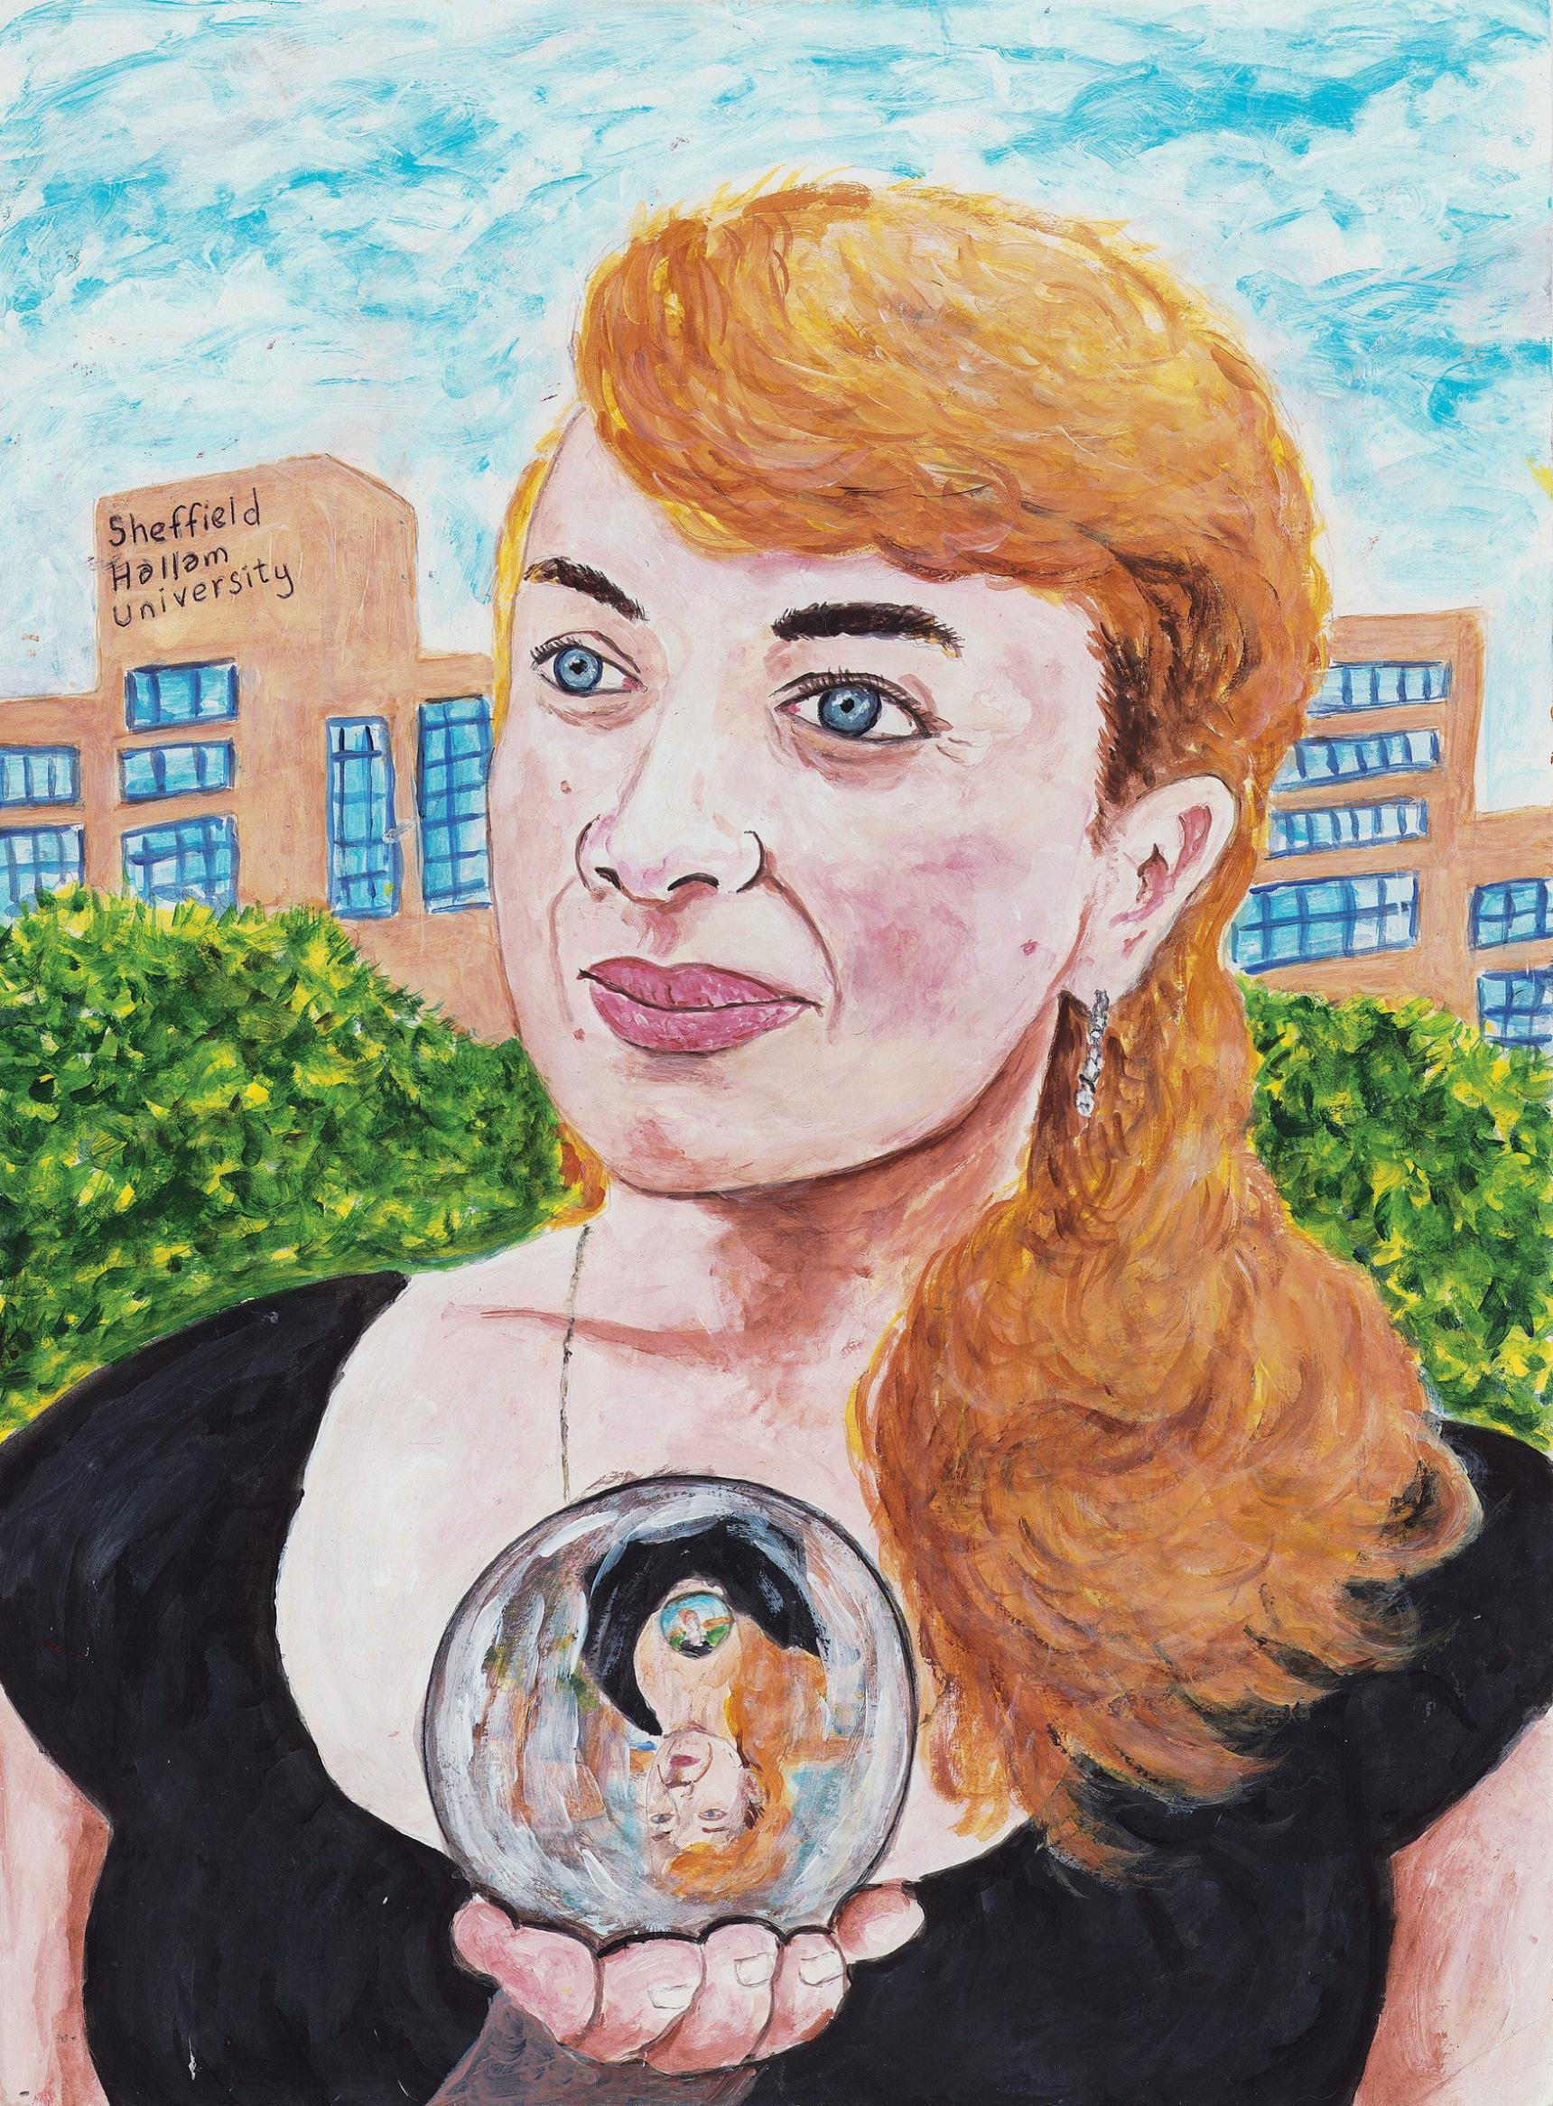
LIUDMYLA
Liudmyla (born 1979) is a refugee in the UK from the war in Ukraine, housed under the programme ‘Home for Ukraine’. She and her teenage son “now live in a wonderful family. We’re safe.” Liudmyla is a qualified teacher. She worked in a kindergarten with children aged two to seven. She has seen her school bombed on the BBC news.
Liudmyla loves drawing, singing and knitting and she has started writing a book, her life story, called ‘Spring 2022’. Liudmyla’s dream is to attend university in England and gain her UK teaching qualifications. She believes in the best and would love to rebuild her life with her son.
Her reality is that she cannot predict and plan for the future. She says: “My son goes to a good secondary school nearby and I study English at college. We had visas for three years of residence in this country, which was recently extended by 18 months. I don’t know what will happen next so my reality is depicted as a crystal ball.”
Liudmyla’s dream is to attend university in England and gain her UK teaching qualifications. Behind her in the painting is Sheffield Hallam University.
Following the tour, Liudmyla says: “I feel good that so many people have seen it... Just yesterday one of my friends texted saying they had seen my portrait, and I feel like they know it’s important. I feel we have made an important step, and I have enjoyed it. Doing this, I found people in the same position as me, and I heard from other people as well. What will happen next? Who knows?! But I am doing what I can, I am studying and improving my English. I believe in the future and I’m looking forward.”

Slide 7
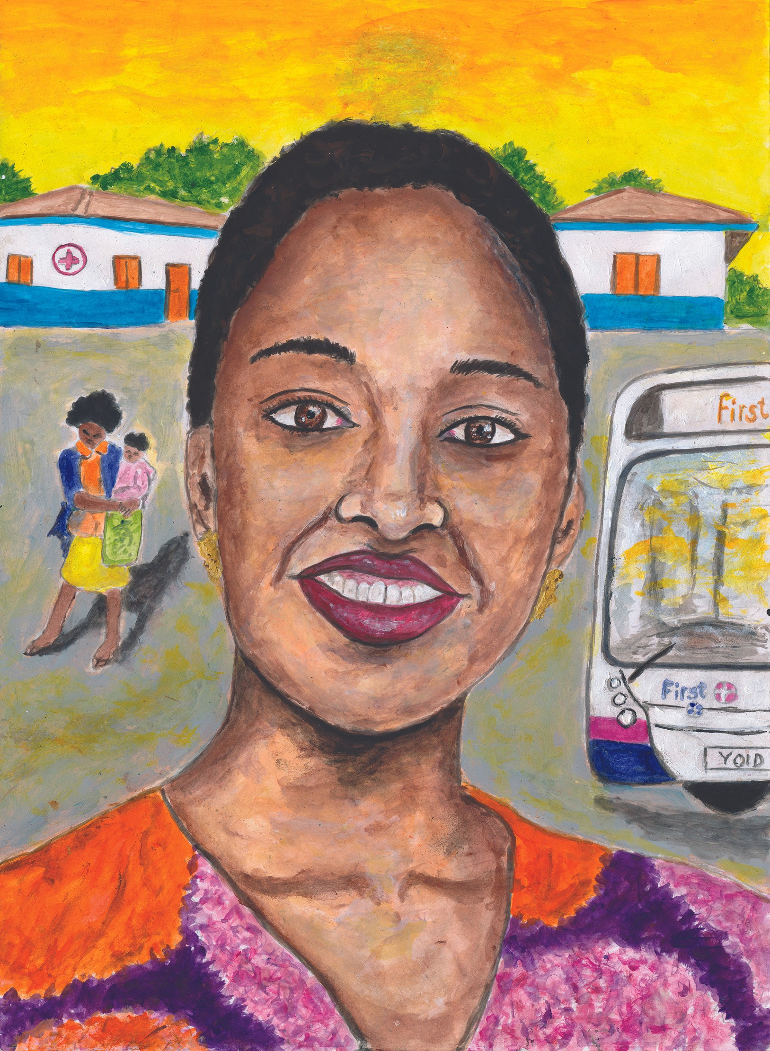
SANDRA
Sandra (born 2003) has completed a foundation degree in Professional Practice in Health and Social Care. She is currently seeking work as an NHS Support Worker.
By the age of 14, Sandra had lived in four countries as a refugee from unrest in Democratic Republic of Congo. For 11 of these years she was separated from her mother. Sandra speaks four languages. She has missed a lot of schooling and stability and is working hard to achieve her maths GCSE which will enable her to access higher level nursing qualifications.
Sandra’s dream is to have a small healthcare centre that provides treatment and educates pregnant girls or women in rural areas of her birth country, Democratic Republic of Congo.
“It would incorporate so many things like: immunisations/ vaccines; children with special need care / awareness; childhood pregnancy support systems (hoping by then the world would
be better); women cancer healthcare; post partum depression awareness / supporting grieving mothers.”
In the short term, Sandra needs more money to help her support herself and her family while she pursues her nursing degree and career.
Sandra’s reality of life on a low income is that she can’t afford the bus fares to college and often has to walk long distances.

Slide 8
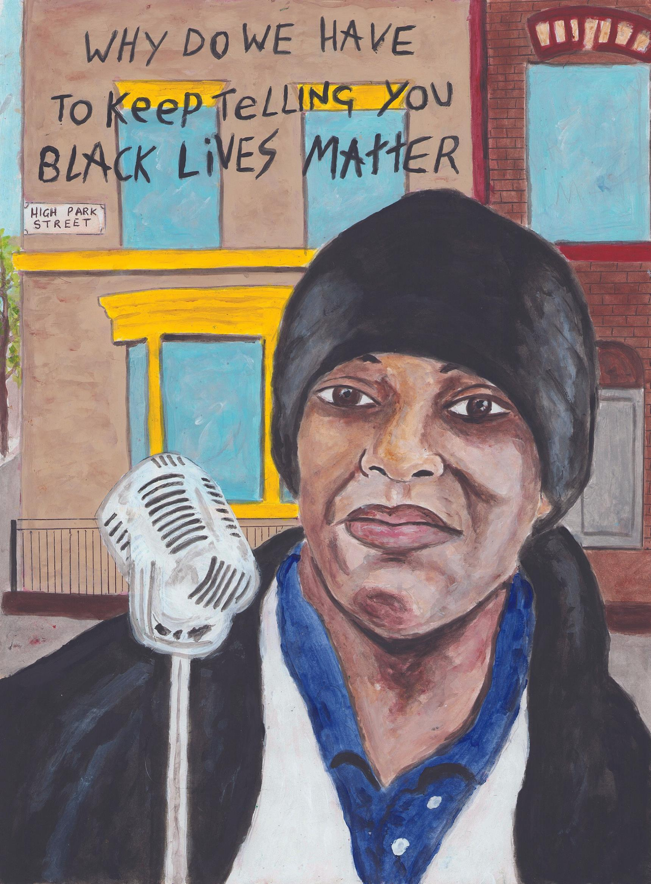
WAYNE
Wayne does voluntary work.
“I serve breakfast to people struggling with the cost of living scandal, homelessness and others and I have a voluntary role as librarian for a Christian group”.
Wayne’s dream is to facilitate sustainable business ideas, using the profits to empower others to overcome issues such as racial injustice
, homelessness and “encountering a system that often works for the few”. Wayne’s own opportunities have been limited by these issues.
Presently, Wayne’s reality is that he is homeless. He has no salary income, and claims no benefits.
“During 2020, when COVID was at its peak, we saw that the government were able to help 300,000 homeless off the streets and into accommodation, which didn’t last. They can do it again as homelessness rises back to 300,000”.
Wayne was one of the volunteers helping the homeless around the clock during the 2020 COVID times.
Following the tour, Wayne says: “My personal situation hasn't changed. I've been working on turning my dream into a reality, and I'm excited to report that I've made some progress. Church Action on Poverty interviewed me for a feature in their magazine. I've also set up a GoFundMe page to support my initiative, Mission50%, which aims to tackle rough sleeping by 50% in one year.”

Slide 9
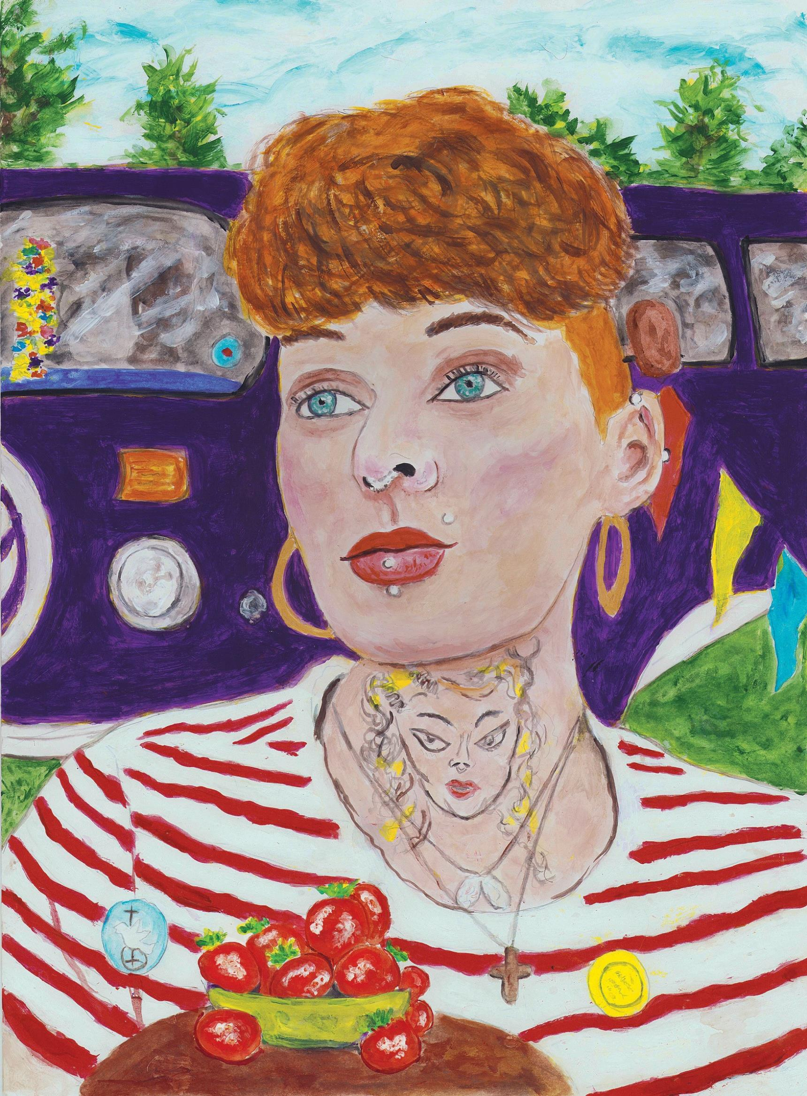
MICHELLE
Michelle (born 1990) has a vision to set up a charity reaching out to women stuck in cycles of homelessness, addiction, prostitution and prison, drawing on her own experience and insights as a recovering addict.
Michelle’s dream is to be a motivational speaker to other survivors, using a camper van to take her and her dog to events across the UK. She is working towards achieving her driving licence.
Living on the frontline of poverty means Michelle cannot afford the fresh fruit she needs. In the portrait, this reality is depicted using her favourite fruit, strawberries.
From the next Government, Michelle hopes money will be directed towards more access to mental health provision and solutions
to homelessness.

Slide 10
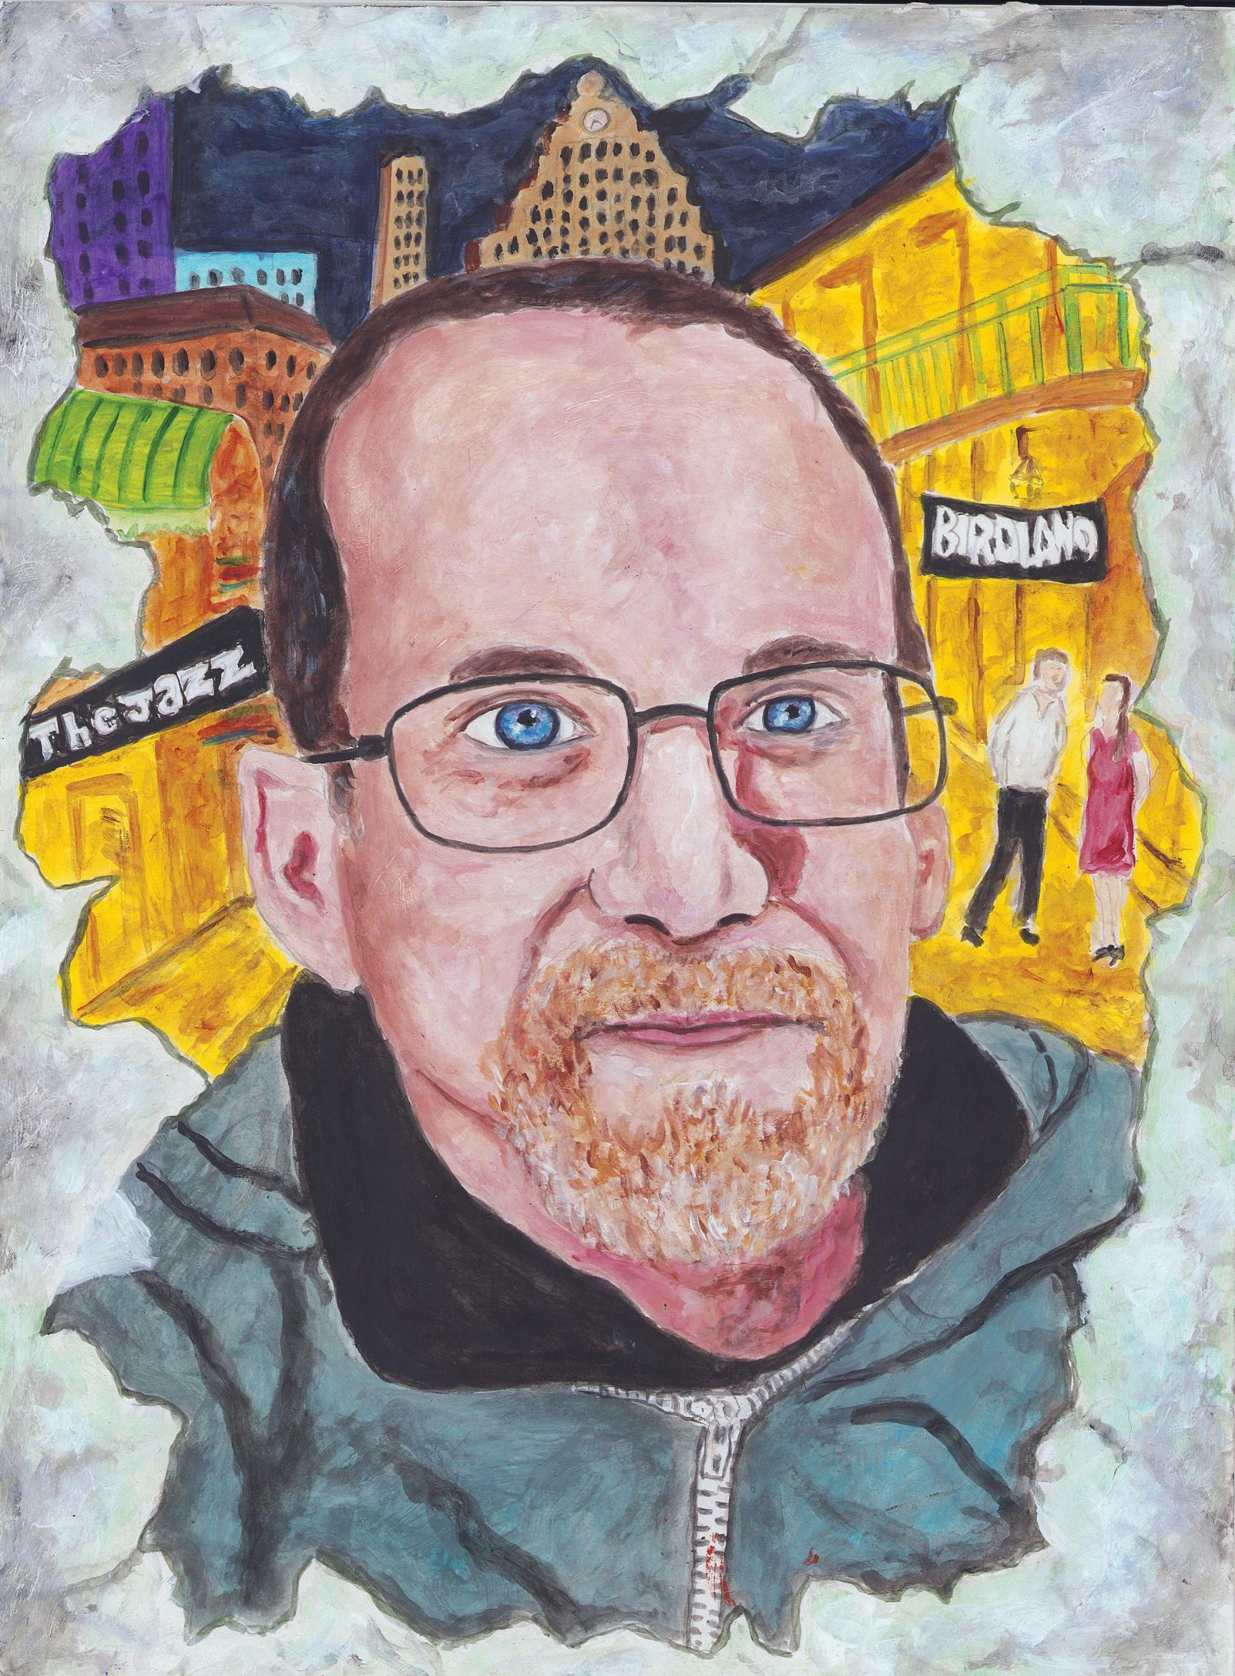
GLEN
Glen (born 1973) is a professional jazz guitarist and community musician. He lives with complex health issues and his music income is supplemented by benefits, due to his fragile health and consequent ‘limited capacity to work’.
Glen’s dream, as a passionate music-maker, is to perform at a New York City jazz club.
His reality is that he has lived with a broken window for six months due to poor mental health and substance abuse issues. Supported by friends, he has been sober since September 2023.
Finances remain tight due to the massive inflation of the last few years. He says:
“Everything is just so much more expensive: food, electricity, heat.”
Glen’s hopes from the next Government include keeping benefits in line with the actual cost of living; increasing access to mental health support services “beyond the over-stretched crisis teams”;
and spending less on “servicing national debt, and instead diverting money directly into addressing the massive problems of addiction, educational underachievement, crime and social decay, endemic in most communities”.

